Slide 1
Cybersecurity Awareness Training
Social Engineering
By Joshua Khokhar

Slide 2
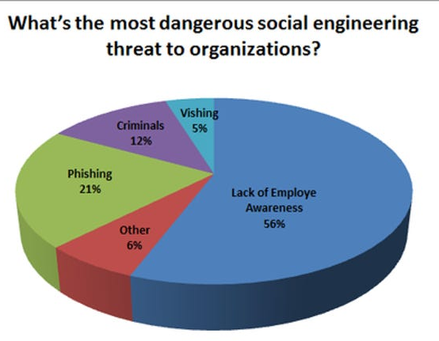
Introduction - What is Social Engineering?
The use of deception to manipulate individuals into divulging confidential or personal information that may be used for fraudulent purposes; The art of human manipulation!
What do they gain? Credentials, control, intellectual property
Why is this training important? 80% of cases of data/information being compromised in an organization involve social engineering

Slide 3
Types of Social Engineering Attacks
Phishing - email
Vishing - phone call/voicemail
Smishing - texts
Phishing via social media (Facebook, Instagram, etc.)

Slide 4
Phishing: What is it? How does it work?
How does it work? Attackers send deceptive emails to trick individuals into giving sensitive information
What do attackers target? An individual’s greed and fear
Example: The attacker sends an email claiming to be from an organization (i.e. work, ministry) and asks you to click a link. The link goes to a fake website which asks you to log in with your username and password. Instead of being the real website, the attacker has just stolen your password and can now access your account
Notes:
Research on the Internet: FaceBook, LinkedIn, Google. Where you work, your email, your job title, etc.

Slide 5
Demonstration

Slide 6
The Most Impersonated Organizations in Phishing Scams
Amazon
Apple
Social Security Administration
Microsoft
Bank of America
Wells Fargo
AT&T
Facebook
FedEx
Comcast

Slide 7
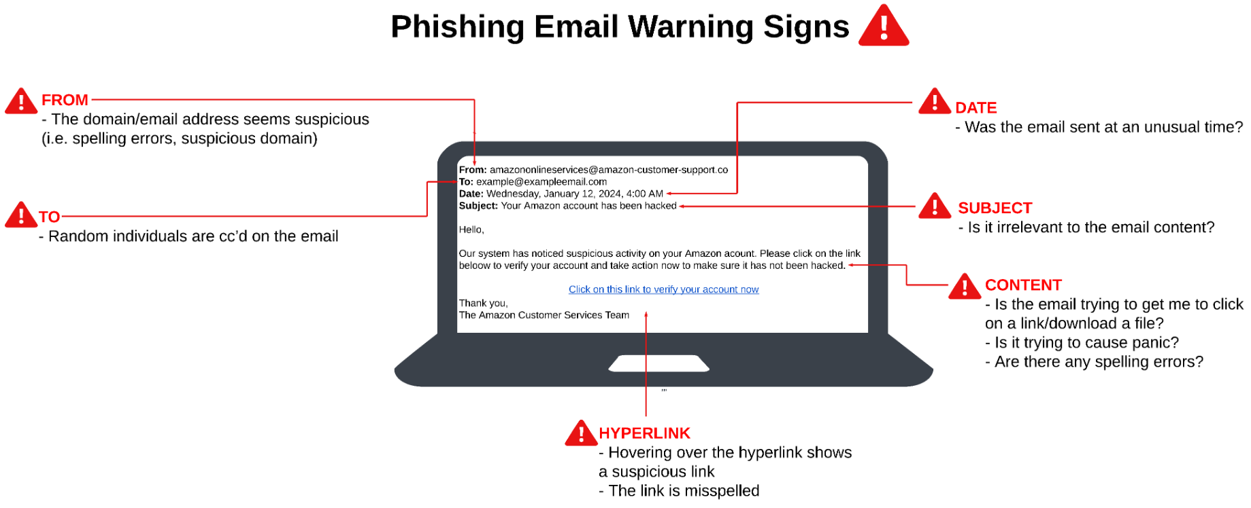

Slide 8
Examples

Slide 9
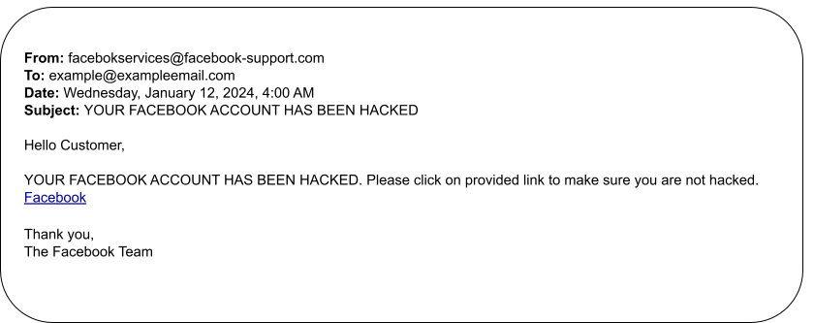
Facebook

Slide 10
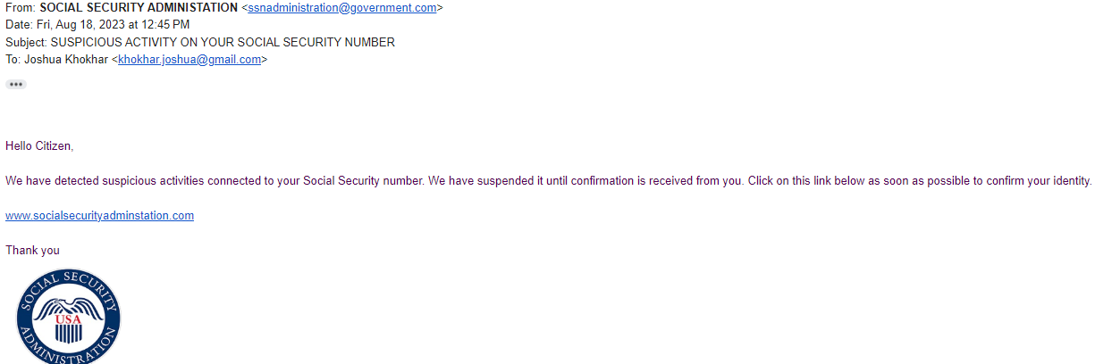
Social Security Administration

Slide 11
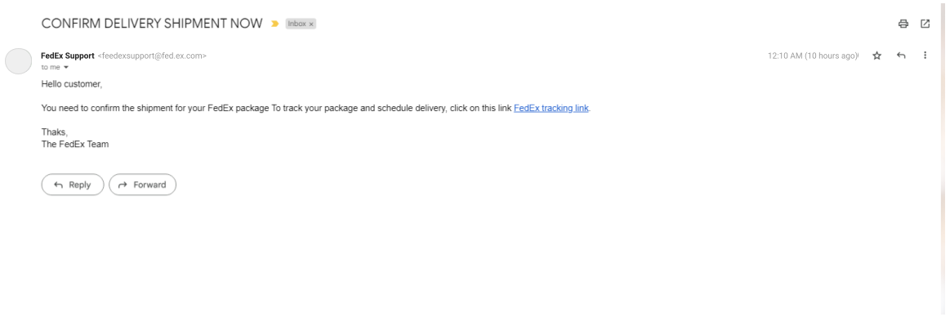
FedEx

Slide 12
How do we protect ourselves from Phishing
User Education like this training
First rule: Stop and think! Does it sound too good to be true?
Second rule: Don’t click on emails you don’t recognize or are not expecting
Keys things to watch out for in a suspected phishing email:
Asks for Sensitive Information
Is not personalized (doesn’t say your name)
Trying to cause panic or seem urgent (a limited offer/account being hacked)
Lack of the company’s logo
Suspicious email address, not matching the company domain
Spelling errors

Slide 13
Conclusion
Social engineering is very dangerous, compromising your important information
Phishing is a type of social engineering attack
Remember the rules for a phishing attack
Reporting phishing: phishing-report@us-cert.gov

Slide 14
Q&A
Thanks for attending

